Slide 1
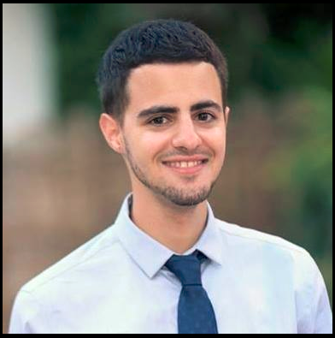
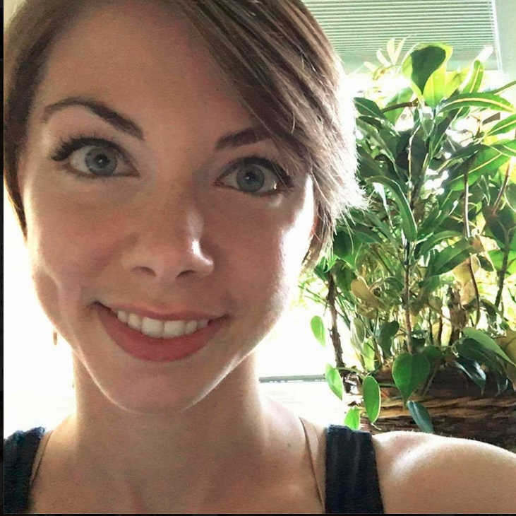
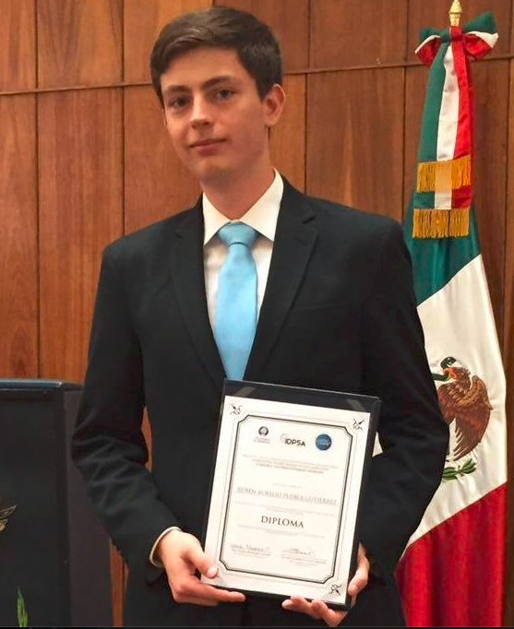
Team 234 Sprint 1 CaPS WebApp
Gal fisher (Scrum master) [GFISHER]
Laura Miller [lauramil]
Ruben Aurelio Puebla Gutierrez [rpueblag]

Slide 2
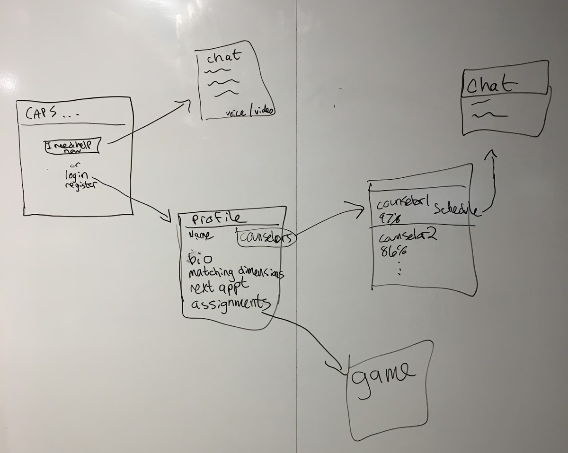
Idea & Specification
Create a web app that will lower the “activation energy” for students to get psychological help from a counselor at CAPS and aid in a more comprehensive treatment program.
Sprint1

Slide 3
Sprint 1 Backlog
Task |  | Owner | Done?
Front-End | Django Templates | Laura | v
 | CaPS + Test framework static pages & style |  | v
 | Chat JavaScript functionality |  | v
Back-End - CaPS | CaPS Models | Gal | v
 | CaPS Forms |  | v
 | CaPS Views |  | v
Back-End – Chat | Chat Models | Aurelio | v
 | Chat\CaPS backend |  | v
 | Admin Site |  | v
 | Chat JavaScript functionality |  | v
Testing | Backend testing | Everyone | vx

Slide 4
Retrospective
Using new technology for us (sockets)
Using a new style library we haven’t used before (Materialize)
Three people working on a large scale project (Git conflicts and merges ☹)

Slide 5
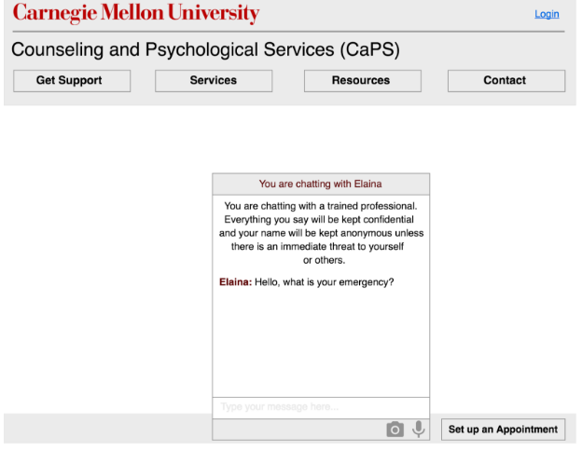
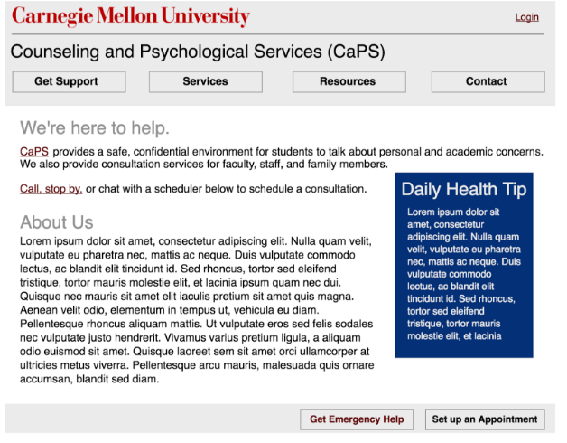
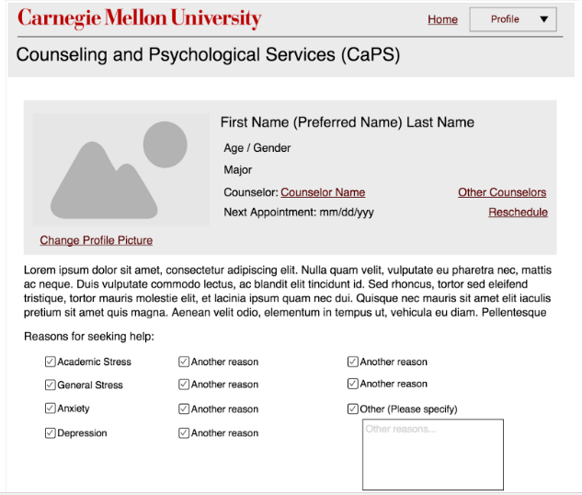
Design – Wireframes vs. implementation

Slide 6
Sprint 2 goals
- Task framework
- Scheduling API
- Statistics

Slide 7
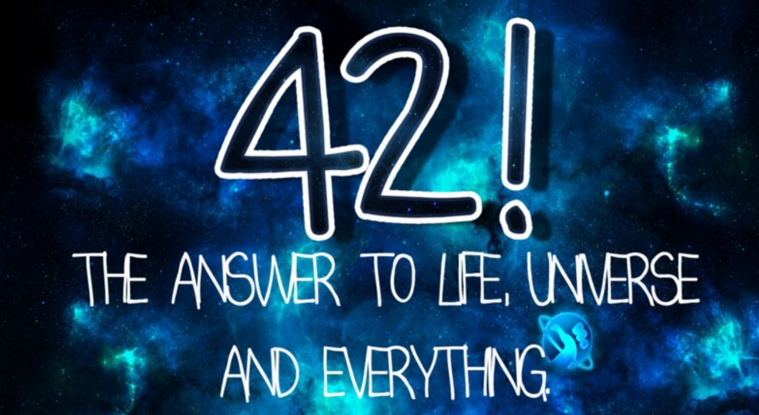
Questions?
Thanks for listening!

